Slide 1
Cognitive Behavior Therapy &
Drama Therapy
Makram Shashtawy, Msc Clinical Psychology

Slide 2
Program
Introduction
Doorbell exercise
CBT
Thought distortions
Drama Therapy
Bus of emotions
Psychodrama – Thechniques
Exposure
Exposure within Drama Therapy
How to implement?
Questions and Anwsers/Discussion

Slide 3
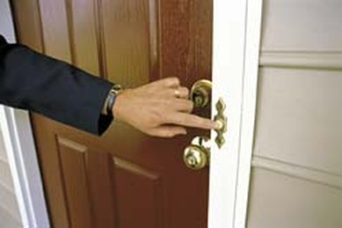
Doorbell Exercise

Slide 4

Starting point CBT
Not the situation itself, but the way people interpret the situation determine how they will feel and behave.

Slide 5
Difference with behaviour therapy
Behaviour therapy:
Essention is behavioral change
Cognitive therapy:
Behaviour is being used to challenge the automatic thoughts. Goal is to get new and more adequate information.

Slide 6
3 Levels of Thought
Core believes
Fundamental believes about yourself, others, the world and the future. Jung called these schemas or core believes
Automatic thoughts
Words and images in specific situations
Intermediair assumptions
Reasoning, strategies (avoiding negative experiences), assumptions.This connects the core believes with the automatic thoughts

Slide 7
Thought distortions/Errors
All or nothing: “if I don’t get an A on my exam, I’m worthless”
Disaster thinking: “I will never make it”
Disqualifying positive thoughts: “I was lucky”
Emotional reasoning: “I just feel it’s like that”

Slide 8
Thought distortions/Errors
Stigmatize: “I’m a worthless person”
Exaggerate/minimalize: “If I get a B, it means i’m stupid. If i get an A it doesn’t mean i’m smart”
Selective attention: more attention towards negative things (Exercise)
Mind Reading: “He thinks I’m stupid”

Slide 9
Thought distortions/Errors
Generalize: “Because I didn’t feel comfortable at that party, means I can’t make any friends”
Personalize: “The meganic acted like that because he doesn’t like me”
Must/Have to be/ Should: “People who make mistakes on work must be fired”

Slide 10
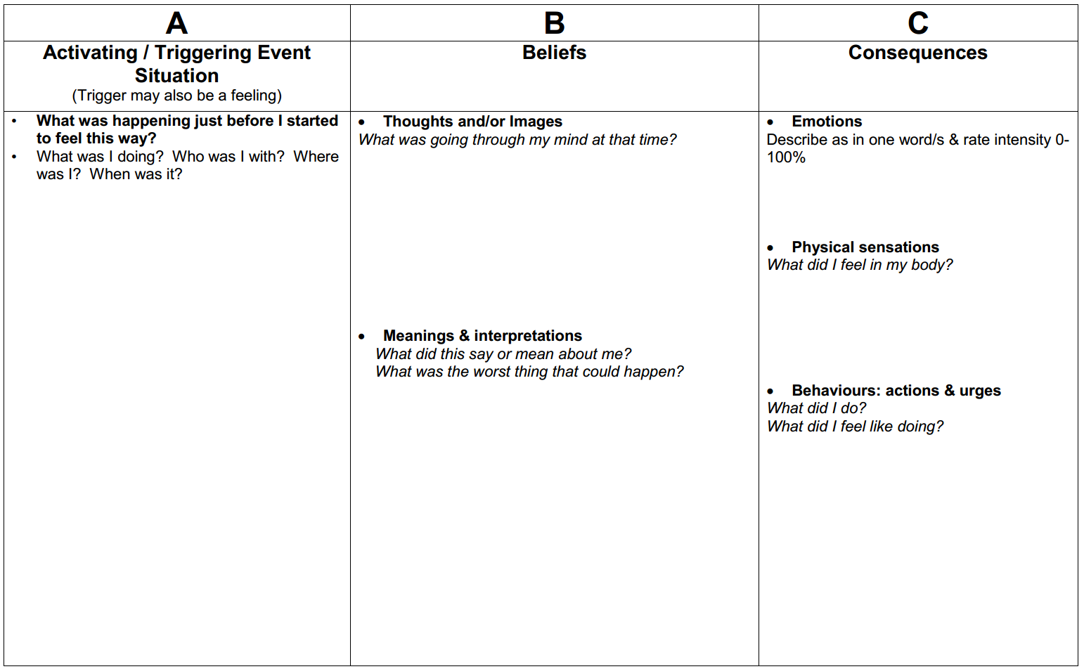
Thought distortions/Errors

Slide 11
Critical Experience
Activation of core believe which will be seen in the automatic thought
Negative feelings
Body sensations
Behaviour
New (disfunctional) Thoughts

Slide 12
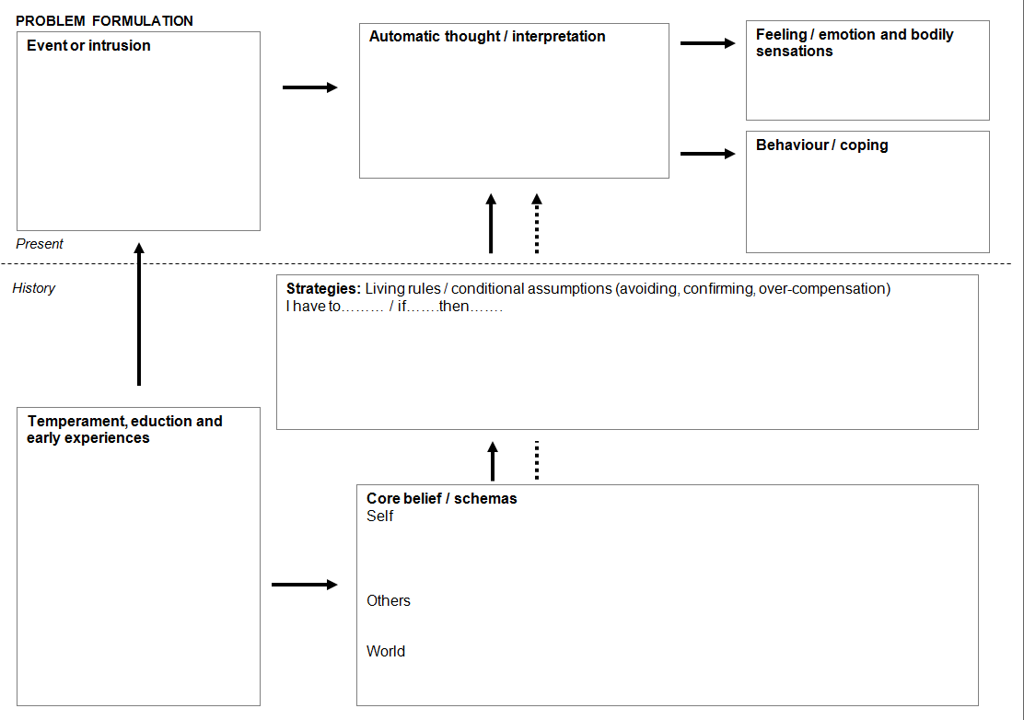

Slide 13
Features of CBT
Complain focused
Sessions are according to a strict structure
Home work assignments are important
Educational
Relation is for as far as possible equal
Cooperation is essential

Slide 14
Experiential Techniques
Exposure
Behaviour Experiments
Imagination

Slide 15
Exposure
Habituation and extinction
  Reduce/extinction of fear
  Break the cycle of avoiding behavior
Time is important
  Stay in the situation untill the level of tension/fear drops

Slide 16
Important with exposure
Rationale
Fear hierarchy
SUD- score
* Subjectives Units of Disturbance

Slide 17

Drama therapy
Jacob Levy Moreno (1914)
Warm up
Action
Closure

Slide 18
Drama therapy
Big part of effect lies in the dramatic projection (Jones, 1996)
Makes it possible to externalize inner conflicts
By using small toys, puppets and masks or role play

Slide 19
Indications
Cognitive Problems
Goals:
Connect thinking, feeling and acting
Knowing the difference between interpretation and observation
Creating structure in thinking
Control of impulses
Increase concentration

Slide 20
Indications
Interaction problems:
Goals:
Create insight in own behaviour and behaviour of others
Know your limits and borders
Adjust to the behaviour of the other
Dare to Take your space
Distance

Slide 21
Indications
Emotional Problems
Goals:
Recognize and express emotions
Control emotions
Regulate emotions
Deal with emotions
Control your impulses
Know how to relax

Slide 22
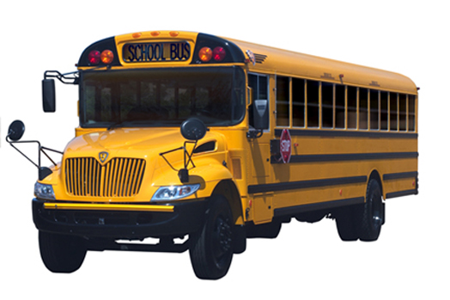
Bus of Emotions

Slide 23
Psychodrama – classical techniques
Role Reversal
Client portrays another person, while a second actor portrays the client
Doubling
The double makes the client conscious of thoughts and feelings
Mirroring
Client plays his role, then another actor takes his role

Slide 24
Psychodrama – classical techniques
Future projection
Play the presumed difficult situation in the future
Surplus reality (as-if)
Play as-if not bound by the difficulties of the client; wished reality
Empty chair
Inter-relational problems; switch chair and take different roles

Slide 25
A combined drama-based and
CBT approach to working with self-reported anger aggression
  (Blacker et al, 2008)
  ‘Insult to Injury’
Aims: An active drama-based approach combined with cognitive-behavioral techniques was used to explore issues such as masculinity, power and control, pride and shame and victim awareness. Reductions in anger were hypothesized.
Method: A single group pre/post design assessed the levels of anger before and after the course. 62 adult male offenders from six prison establishments in the UK took part in the nine-day course.

Slide 26
A combined drama-based and
CBT approach to working with self-reported anger aggression
Result: As hypothesized, significant reductions in anger were found in pre- to post-course assessment.
Conclusion: These results suggest that a drama-based approach may be a promising adjunct to traditional anger management programmes for violent offenders.

Slide 27
Exposure within Drama therapy

Slide 28
Gradual Exposure within Drama therapy
Make a list/hierarchy of the fearfull situations
Example:
Client’s biggest fear is to speak on stage for 20 people.
Alone on a stage without saying anything, while 2 people are watching
Easy to play within the dramatherapy

Slide 29
Behavioural experiment
Challenge the Automatic Thought
Adjust the Automatic Thought to a more realistic thought
Compare your predictions with the result of the experiment

Slide 30
Behavioural Experiment
Use an experiment form
Create a 0 hypotheses (Automatic Thought)
Create an alternative hypotheses (Alternative Thought)
Score the reliability of these thoughts both before and after the experiment

Slide 31
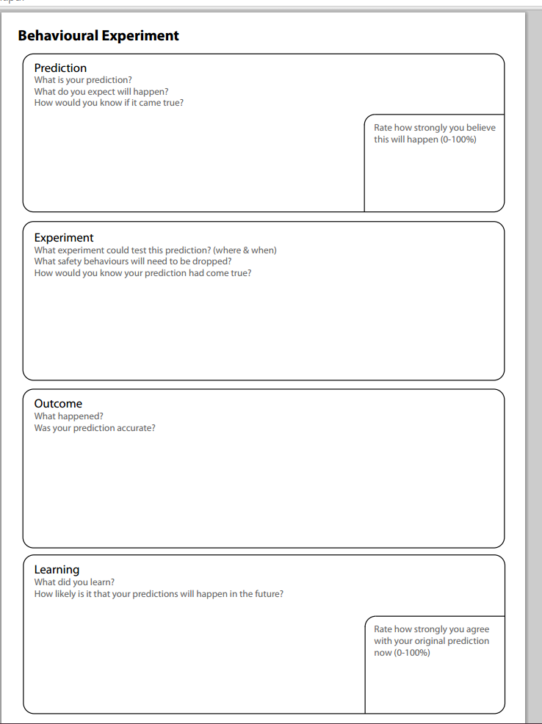

Slide 32
Behavioural Experiment
Client and other groupmembers or client and therapist prepare a scene. Client learns his lines partly or makes mistakes on purpose.
Afterwards; evaluation.

Slide 33

Imagination
Playing the scene which causes disstress in the client.
Rescripting possible by giving groupmembers a role in the play.

Slide 34

Verbal Challenging
Court technique; Devil’s advocate
Make it a real scene which you prepare in advance

Slide 35
Verbal Challenging
Cost/ Benefit anlysis
1. Disfunctional thought:
If I set my limits, people will reject me, which will have negative consequences for my future
Rating: 85 on a scale 0 – 100
2. Alternative thought:
If I speak out my limits and borders, I will take better care of myself and this will have a positive effect for me
Rating: 30 on a scale 0 - 100

Slide 36
Verbal Challenging
3 & 4. Divide the therapy space in to 4 parts. 2 parts for the cost/benefits analysis of the disfunctional thought and 2 parts for the alternative thought.
Client is being asked to choose a symbol for every cost and benefit. Working with symbols, gives an extra connection with what you’re symbolizing

Slide 37
Verbal Challenging –
Disfunctional thought
Costs | Benefits
People cross my borders/limits Symbol: Rope | I’ll keep my job Symbol: Contract
Difficulty with concentration Symbol: book | I can take care of my family Symbol: coins
I need alcohol to reduce the tension after work Symbol: glass | Family is happy that I have a job Symbol: happy smiley
Not able to finish all my work Symbol: a checklist
Comments from my boss Symbol: Jacket of a chief
I worry the whole day about my work and family Symbol: too small hat

Slide 38
Verbal Challenging –
Alternative thought
Costs | Benefits
Higher chance of losing my job Symbol: contract in pieces | Less worying Symbol: flowers
People will get angry because I’m not always there fro them Symbol: Angry smiley | More time to finish my own work Symbol: Checklist
 | Less tension Symbol: destress ball
 | People know my limitations and adjust to that Symbol: doctor’s jacket
 | Not dependent to alcohol Symbol: Glass with a red cross
 | More time for own hobbies Symbol: favourite magazine

Slide 39
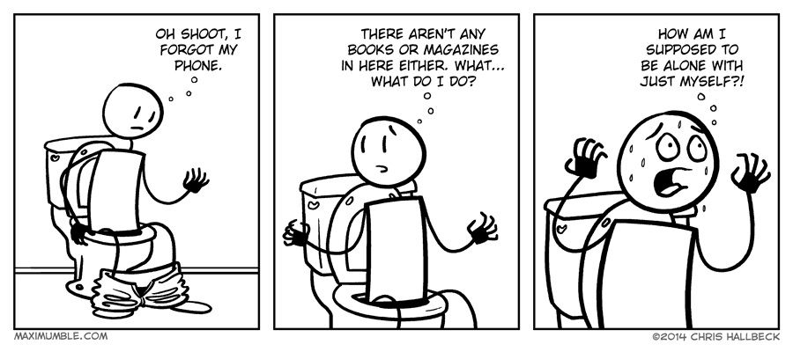
Worst thing that can happen
Play it!

Slide 40

Questions and anwsers

