Slide 1
Assessment
Dramatherapy

Slide 2
Why Assessment?
Dramatherapy is a clinical practice that uses formal and validated assessment and evaluation tools to measure its effectiveness and outcomes
Provides a summary and analysis of the creative-therapeutic work, evidencing change.

Slide 3
Kids with Learning Disabilities, for example:
Enhanced confidence, self-esteem and emotional resilience
Greater security & self-awareness of safety.
Improved communication and socialisation skills
Improved concentration, memory, and attention
Increased body and sensory awareness
Greater awareness of boundaries – space, people
Abilities to overcome difficulties with relationships

Slide 4
In Dramatherapy, Assessment is Continuous and Ongoing

Slide 5
Initial Assessment
Motivation, willingness for drama therapy sessions
Willingness to change, play creatively
Clinical history and personal/social background
Willingness to play role
Ability to communicate

Slide 6
Ongoing Assessment
Ability to express feelings, become acquainted, accept feelings of others
Find community with the group
Make contact with the therapist
Spontaneity and catharsis
Explore personal pain
Handle fears, share differences with others

Slide 7
Final Assessment
Self-esteem, awareness, acceptance
Hope, communication, trust, spontaneity
Self-other awareness, social interaction
Creativity, initiative, imagination,
Concentration, reduced depression
Realistic world view, social self-control
Physical appearance, use of language

Slide 8
Some Assessment Techniques in Family Therapy
Want Ads (for a perfect parent, child, spouse, marriage, solutions, etc.
Guided Imagery (imagine a videotaped clip of your last marital argument. Watch it in your mind and, edit it, without changing your partner’s part, but focusing on changes you could make in your own emotional volatility or other responses.
Photographs (to trigger discussion and insight, to observe stance and position, to compare before to after, to notice what has not been noticed before)
Role-play or psychodrama (to gain a window into family dynamics. Ex: re-enact holidays, dinner table conversations, etc.)

Slide 9
Sculptures (family members can each sculpt the other family members, positioning and expressing them in line with their own perceptions. This can be done comparatively – now and if it were better some day; now vs then). Or each family member can sculpt only themselves, in relation to the group, or can make a doll or position a chess piece. Or in a linear sculpture, members place themselves or each other along a line to denote hierarchy/power in the group, or to indicate position on a family controversy/conflict. Or a couple can be placed in a relationship sculpture.

Slide 10
Incomplete prompts for free association, sentence completion, storytelling,
The Talk About game (A person has the ball, states a topic “tell me about ….” And then tosses the ball to someone who now has 10 seconds to make 5 relevant statements and then choose another topic and toss the ball to someone else.
Metaphors (what part of a car would you be and why? What article of clothing/movie/song/ describes you and why? What color are you and each of the others in your family? What fairy tale or nursery rhyme describes your experience?).
Or, think about your family members in a symbolic way, like you were dreaming or like you they are characters in a Bible story, cartoon, historical event, cultural myth, etc., so that you can describe your family in relation to one another.

Slide 11
Dramatherapy Results are Visible
Engages in productive and self-fulfilling activity
Sustains emotionally warm relationships
Enjoys non-serious activity like playing, just for the fun of it
Appreciates the quality of life, beauty and mystery of life, and expresses it

Slide 12
Cognition
Evidenced through all senses
Emotions felt through senses
Uses touch as communication
Uses sounds as expressions
Being happy in their own company and in the group
Capable of deep relationships with others

Slide 13
Case Study 1 – Madurai Prison
One year 2001-2002 weekend workshops with 10 life convicts
Problems: depression due to loneliness and suppressed sexuality
X had not laughed once in 5 years
Always lonely
Intervention: games , improvisation, enactment through stories

Slide 14
Process and Outcome
Play back theatre through improvising
Imaging
Narrating stories based on imaginary situations
Improvised with objects
Opportunity to fantasize sexuality
X laughed as he clowned

Slide 15
Case 2 – Madurai Prison
A case of acute mutism: schizophrenia
Passive withdrawal symptoms.
Lack of social life and interaction
His problem: powerless emotions, autistic tendencies
Need for communication and the rejection or the fight against communication
He can speak but refuses to speak.

Slide 16
Process and Outcome
Tried to introduce games involving interaction
His interest in the TV serial Sahana was an opener to break ice
Improvising with sounds: music played on tape
Music appreciation: begins to tap fingers
Learned to use sounds as communication: ability to communicate improves. Begins to talk

Slide 17
Use and Assessment - Trauma
Use with children or adults who have trouble responding to questions or describing feelings in verbal form.
Useful in addressing specific somatic manifestations of trauma (i.e., sensory defensiveness, somatic memories, etc.).
Use for vicarious trauma (therapist trauma) – in negative effects of working with those with trauma. Treating the disruption of the therapist’s schemas about the self and the world.

Slide 18
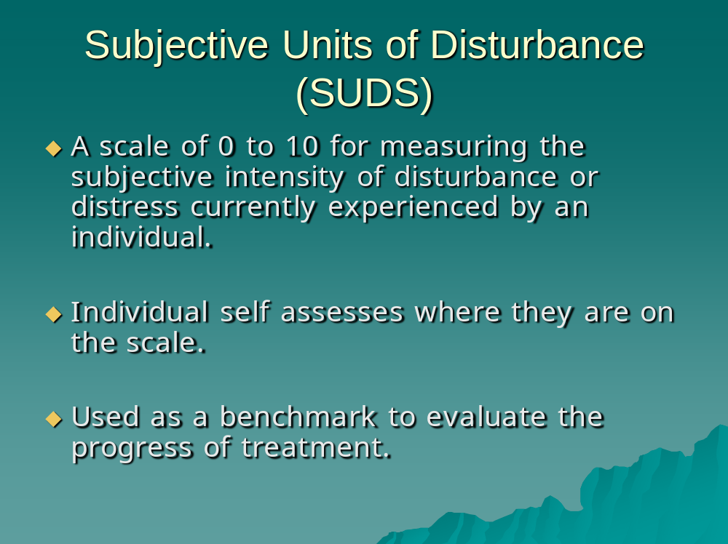
Subjective Units of Disturbance -- SUDs

Slide 19
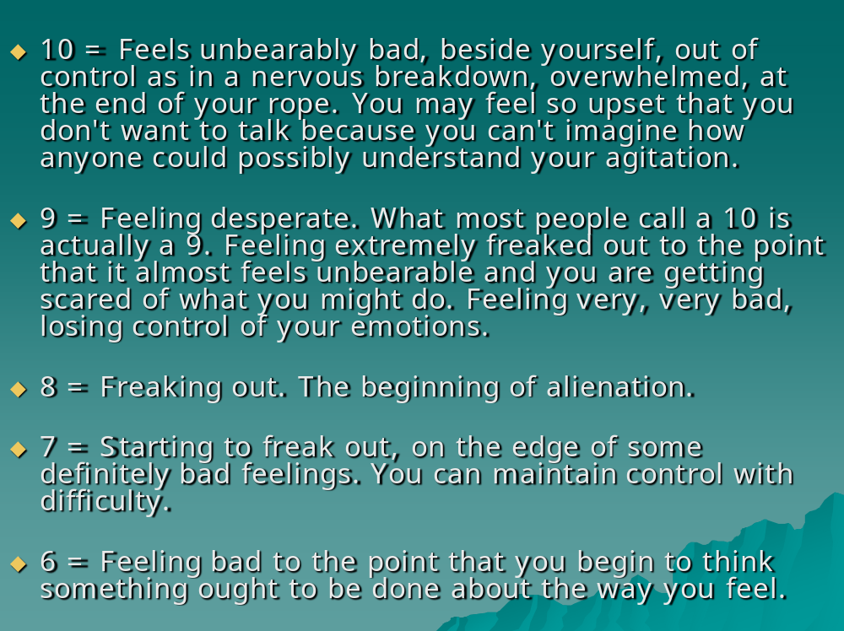

Slide 20
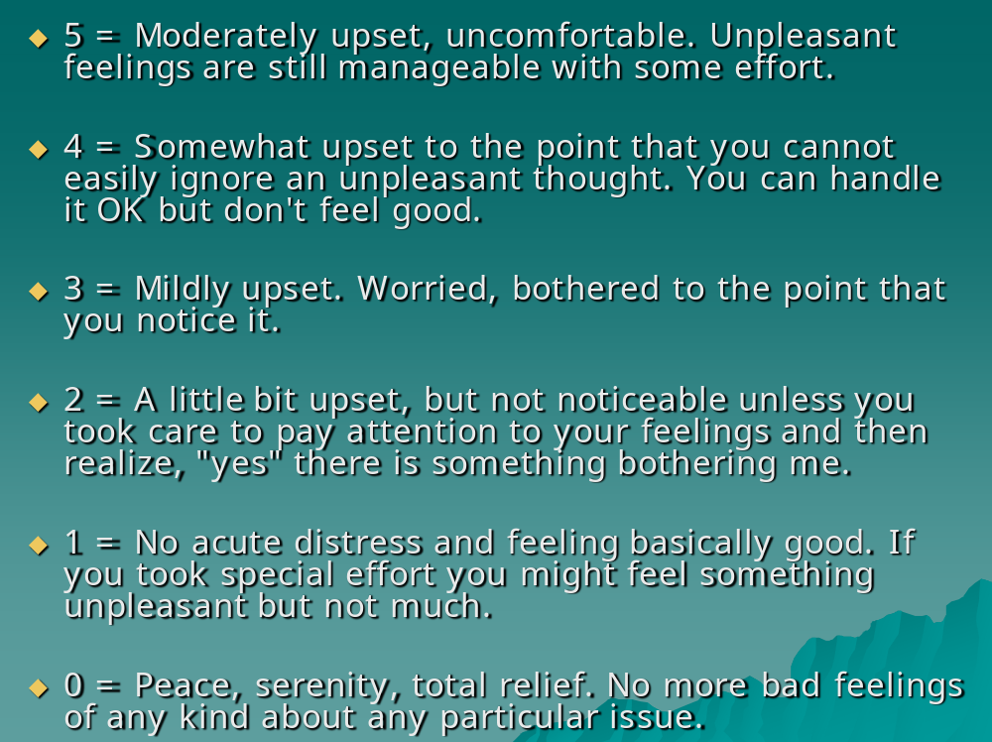

Slide 21
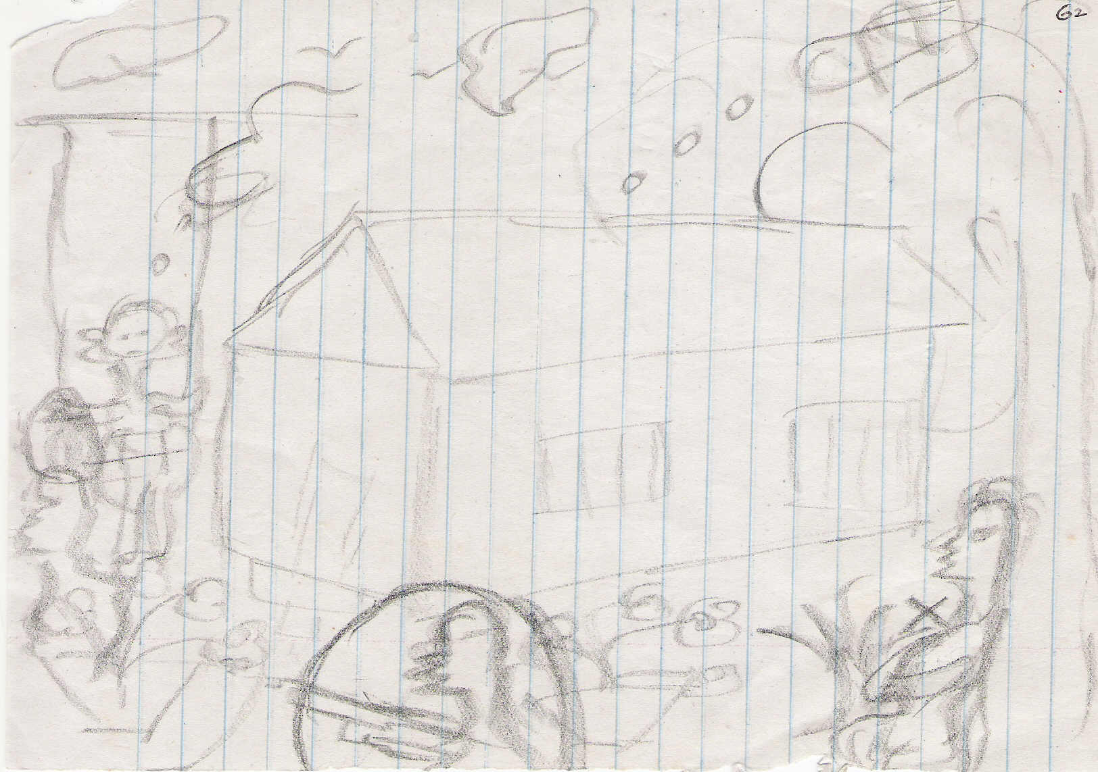
Somatic Manifestations

Slide 22
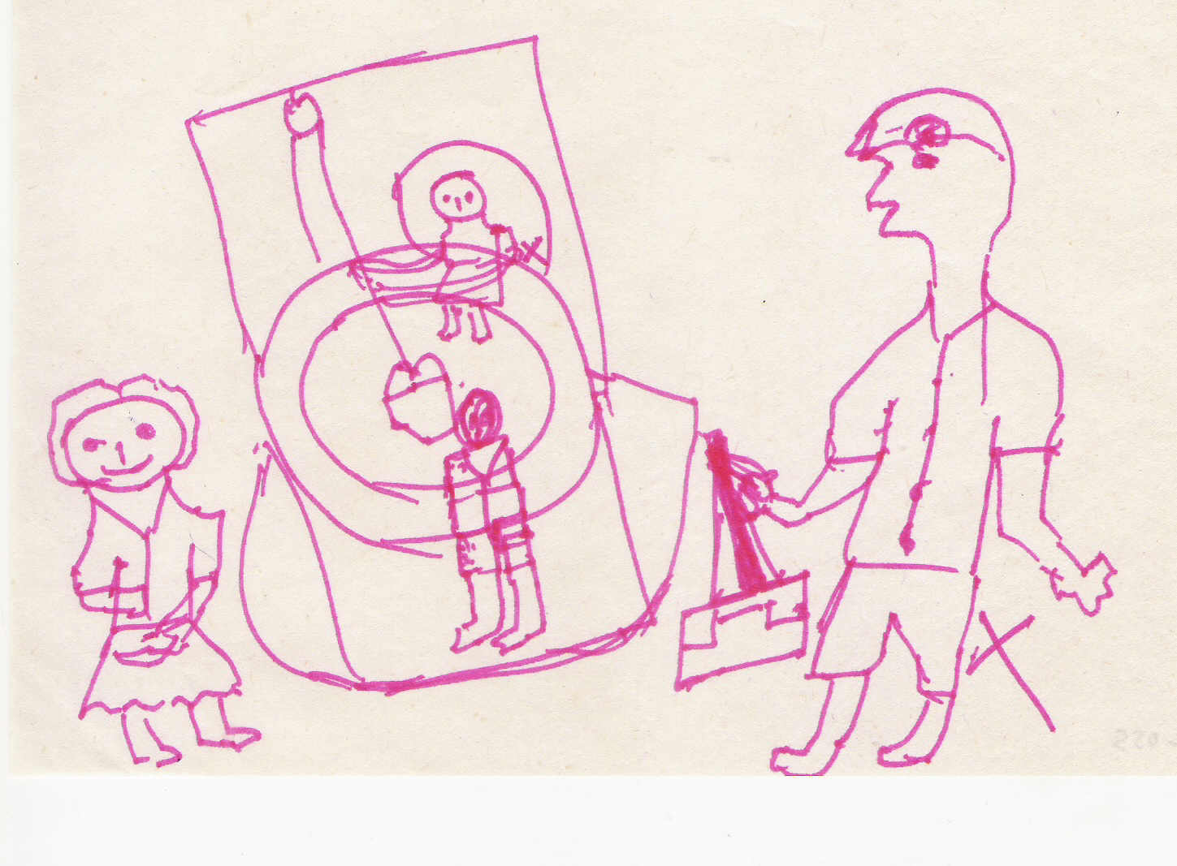

Slide 23
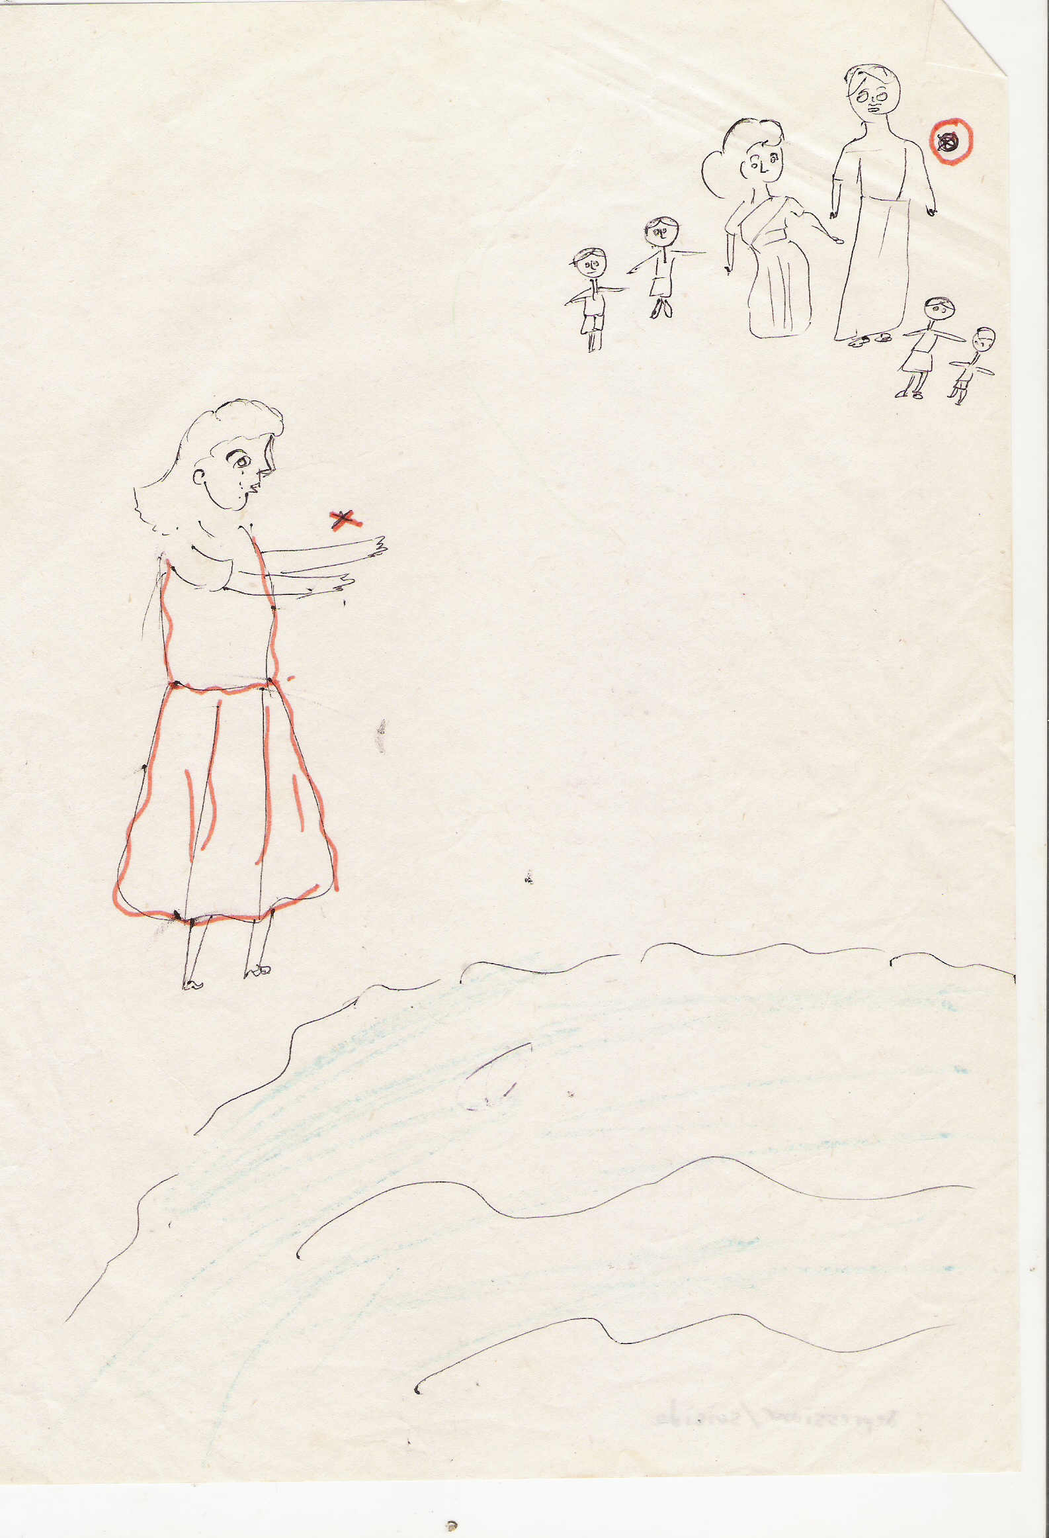

Slide 24
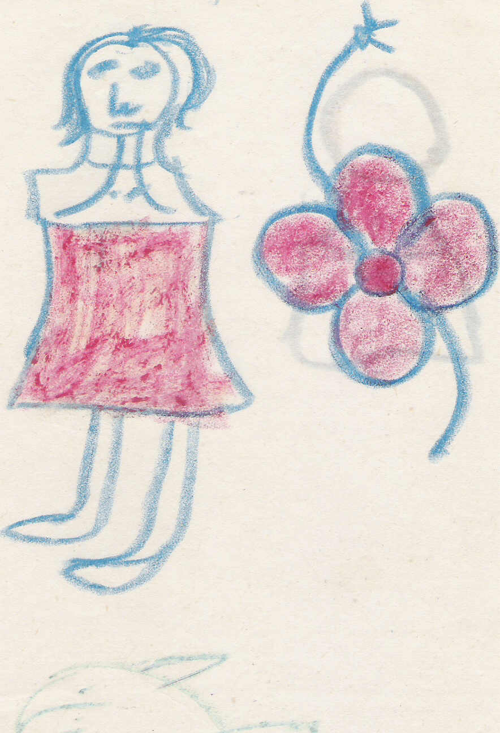

Slide 25
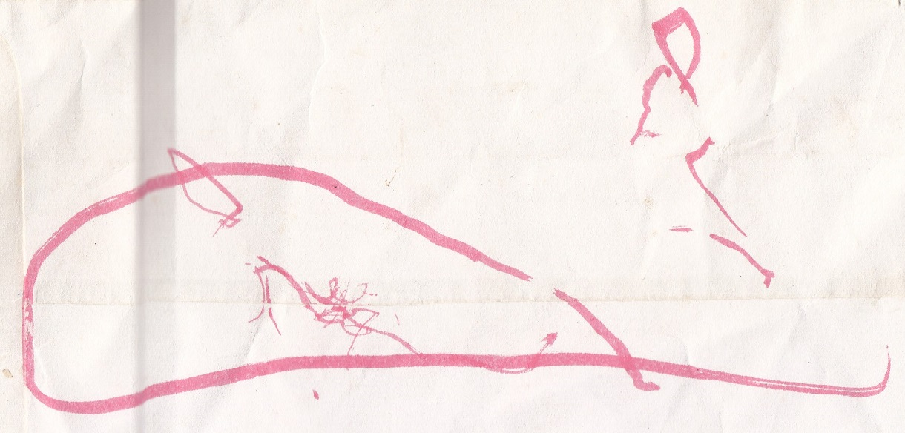

Slide 26
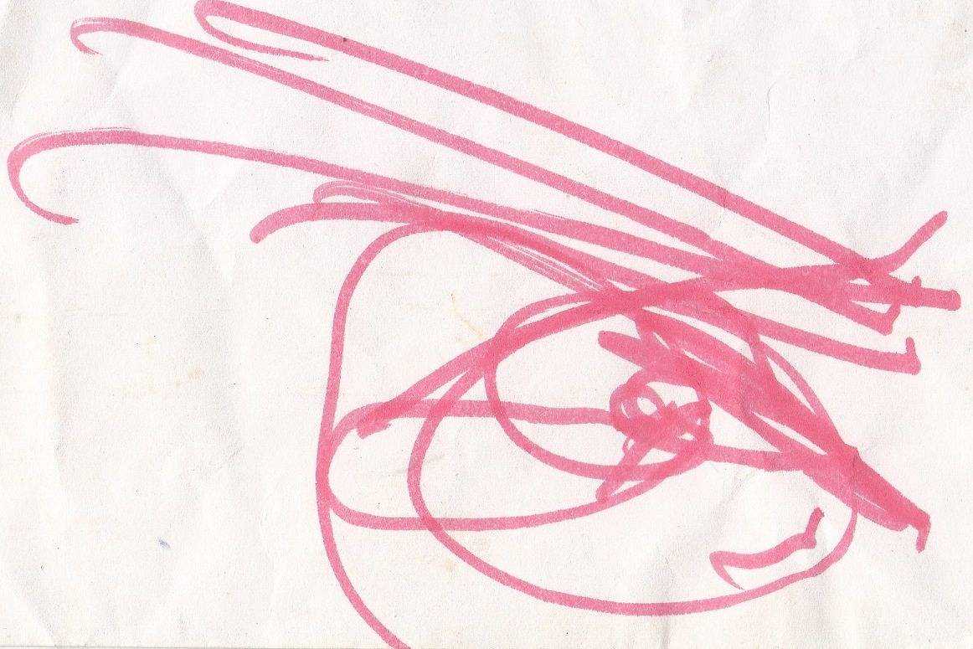

Slide 27
Significant Trait Indicated | % Incidence in Before Drawings | % Incidence in After Drawings (sample 1) | Improvement
Happy Face | 25 | 44 | 19
Neutral Face | 19 | 32 | 13
Sad Face | 35 | 15 | 20
Angry Face | 8 | 2 | 6
Tears | 11 | 2 | 9
Missing Mouth | 14 | 3 | 11
Head Only | 19 | 15 | 4
Profoundly Long Neck | 17 | 4 | 13
Profoundly Protruding Ears | 13 | 8 | 5
Missing Arms | 7 | 0 | 7
Profoundly Short Arms | 15 | 9 | 6
Injured Limb | 1 | 0 | 1
Melting or No Body Integrity | 8 | 6 | 2
Body as Insect | 2 | 0 | 2
Body as Bird | 4 | 0 | 4
Body as Flower | 4 | 0 | 4
Body as Sun | 1 (no face) | 1 (happy face) | 1
IDP Status | 3 | 0 | 3
With House | 3 | 8 | 5
Carrying or Doing Something | 6 | 13 | 7
With the Dead | 0 | 6 | 6

Slide 28
a move from 43% sad and angry to only 17% sad and angry
a move from 44% happy or neutral to 76% happy or neutral
14% indicating an inability to speak of what happened (missing mouth) to only 3%
17% feeling overly-dependent (very long neck) to only 4% feeling so
13% noting concern with what they hear or have heard to only 8%
A complete reduction in missing arms (perception of being unable to extend themselves into the environment to act upon it, to exert intention) from 7% to zero.
Reduction in short stunted arms (a stunted ability to exert intention by extending oneself into the environment and acting upon it competently) from 15% to 9%
A reduction from 19% of students whose body image lacked integrity (discontinuously drawn or abstract) or was not perceived as primarily human (insect, flower, sun, bird) to only 7%. Some of the birds in the before training self drawings had broken wings, and the sun had no face. In the after training self drawing, all but one sun were human and the sun had a smiling face.
Increase from perception of self as active (doing or carrying), 6% before to 13% after

Slide 29
Lali
Ghost Child
Massacre Trauma ---- Loss, Injury, Death
Sad, Needy, Marginalized, Shy
Interventions: Music Therapy, Drama Therapy (role-enactment, sensory and video expression), Acknowledgement, Empathy, Love
Visible Outcome:
  Integrated Mandala (spiritual body)
  She went up and never returned
  Her brother (spirit) made inquiry and left satisfied

Slide 30
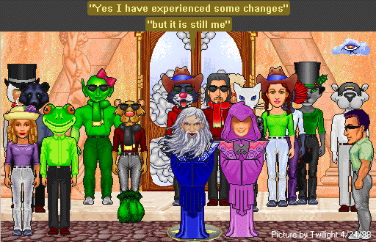
CyberDramatherapy

Slide 31
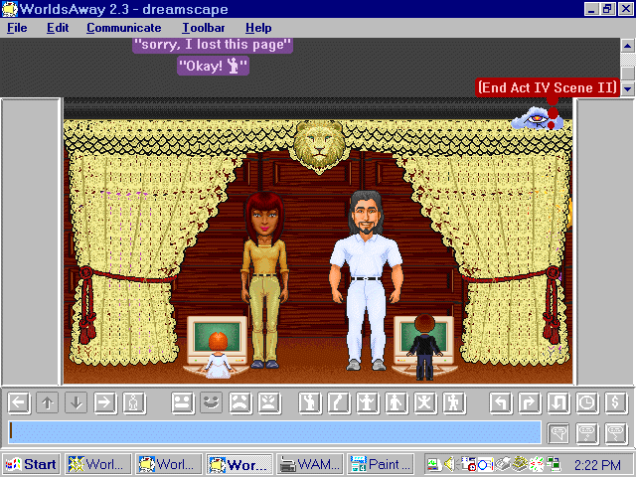

Slide 32
I focused my research on the process by which avatar development is instrumental in ratava (offline self) transformation.
It is evident, based on my data, that transformation is positively correlated with the degree of interpenetration between ratava and virtual embodiment experience.
The level of ratava dissociation is high to the extent that avatar actions and attitudes are experienced as being separate from ratava imperative and unanticipated, even at times shocking to the ratava.
Because interpenetration refers to the engagement of and impact upon the ratava whose avatar(s) are dissociated to act on the virtual environment, an appropriate criteria for measurement of interpenetration was:
  What level of ratava dissociation is reached ?
  To what extent is there seepage (flow of information or degree of re-association from avatar(s) to ratava) ?

Slide 33
I identified four categories of interpenetration: Factitious, Playground, Community, CyberShamanic. These interpenetrative possibilities are based on varying ratios of dissociation and seepage.
 | Low Seepage | High Seepage
Low Dissociation | Factitious | Playground
High Dissociation | Community | Cybershamanic

Slide 34
12 Process Driving Dynamics
Exposure
Trance
Self-Expression
Self Observation
Mythic Ornamentation
Space Appropriation
Increasing Concern for Non-Corporeal Essentials

Slide 35
8. Depoliticizing Diversity
9. Increased Empathy
10. A Calling
11. Reverence for Elders
12. Recognizing Connection
a) Initiatory Dismembership
b) Holographic conception of selves
c) Hyperspatiality
d) Self-Realization

Slide 36
These are the dynamics you can assess also in Dramatherapy.
Connection
Self- Realization
Holographic Self Perception
Hyperspatiality

Slide 37
What is Hyperspatiality Outside Cyberspace?

Slide 38
The Embodied Mandala Method as an Assessment Tool in Drama Therapy By Nisha Sajnani 2002
Guide
What provides one with direction
Skills
What a person is good at
Vulnerability
Situations in which one is weak/exposed
Artist
Creative resources Creative Self
Belief

Slide 39
The purpose of dramatherapy is to bring these role quadrants into balance, in relation to the core, for wholeness and wellbeing. The more in balance they are, the more growth and dynamic transformation and self-actualization is possible.

Slide 40
Instructions
Draw the mandala structure
Fill it in with relevant forms
Imagine it on the floor
Define the quadrants with labels
Walk around it slowly, reflecting on its size and content
Walk into the first quadrant that attracts you. Gain sensory experience of it by reflecting on questions about its color, temperature, smell, taste, sound, what part of my body does it affect most, what is my breathing like, what surrounds me?

Slide 41
Next, enter the space you feel most comfortable in. Reflect.
Enter the space you feel safest in. Reflect.
Enter the space that you feel is the least explored in your life
The space that gives you confidence
The space that provides you strength
Now stand in each space with a sculptured stance and provide a monologue of your experience
Now stand in the center of the mandala and deliver a brief monologue on your relationship to the other sections of the mandala and also to the world outside the boundaries of the mandala.

Slide 42
Exit the mandala
Discuss the experience

